Slide 1
CHAPTER 12
IMAGE RESTORATION

Slide 2
WHAT WILL WE LEARN?
What is noise (in the context of image processing) and how can it be modeled?
What are the main types of noise that may affect an image?
What is blurring (in the context of image processing) and howcan it be modeled?
Which noise removal techniques are typically used in image processing?
Which deblurring techniques are typically used in image processing?

Slide 3
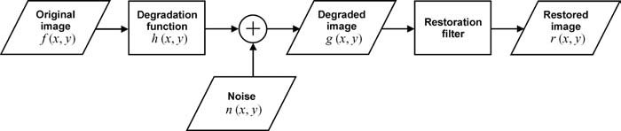


IMAGE DEGRADATION AND RESTORATION PROBLEM

Slide 4
Restoration filter
Collect knowledge about the degradation process
Use that knowledge to develop a degradation model.
Develop the inverse degradation process and model it as a filter.

Slide 5
NOISE AND NOISE MODELS
Gaussian Noise
Impulse (Salt and Pepper) Noise
Uniform Noise
Rayleigh Noise
Gamma (Erlang) Noise
Exponential Noise

Slide 6
Noise Estimation
It is often necessary to estimate the type of noise (and the main parameters of its PDF) before designing a solution for noise reduction.
If primary source of noise is sensor: generate test images consisting of large patches of homogeneous gray-level values and observe the resulting histograms
Crop a relatively large homogeneous region from an image and inspect its histogram

Slide 7
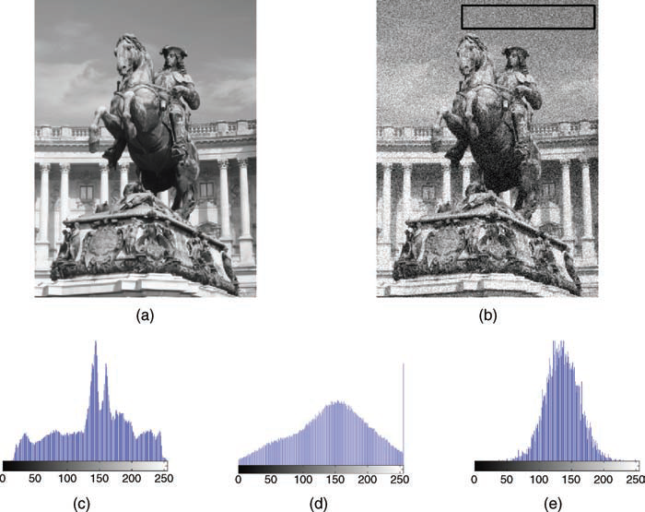
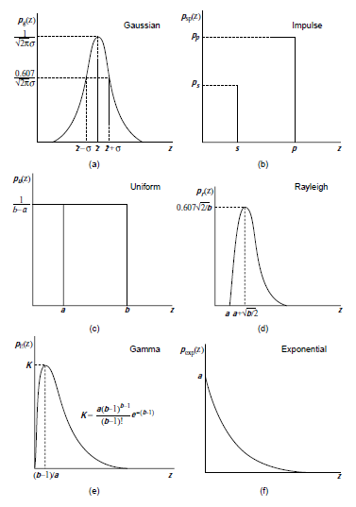
(a) original image; (b) noisy image (c) histogram of the original image; (d) histogram of the noisy image; (e) histogram of selected patch showing clearly that the noise is of Gaussian type in this case.

Slide 8
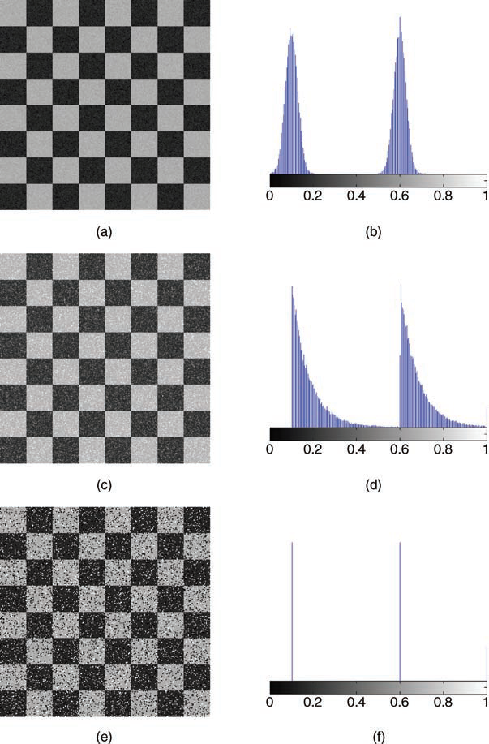
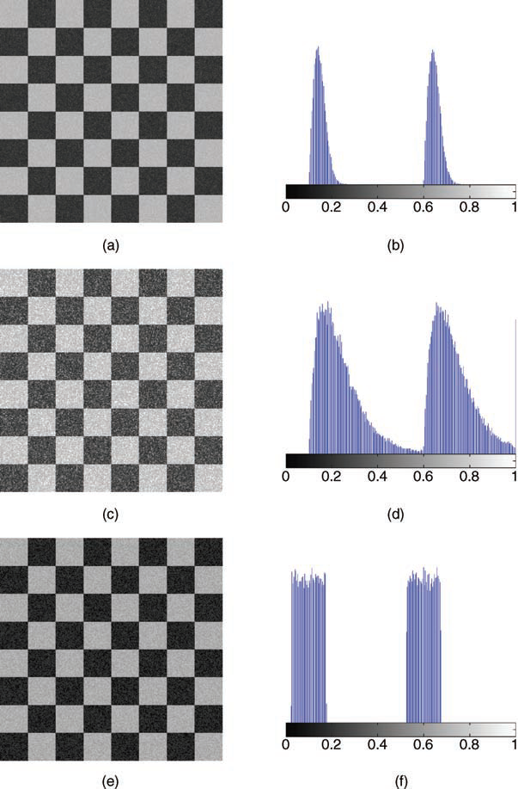
((a and b) Rayleigh;
(c and d) Gamma;
(e and f) uniform.
.
(a and b) Gaussian;
(c and d) exponential;
(e and f) salt and pepper.

Slide 9
Image Restoration Techniques
NOISE REDUCTION USING SPATIAL-DOMAIN TECHNIQUES
NOISE REDUCTION USING FREQUENCY-DOMAIN TECHNIQUES
IMAGE DEBLURRING TECHNIQUES

Slide 10
NOISE REDUCTION USING SPATIAL-DOMAIN TECHNIQUES
Mean Filters
Arithmetic Mean Filter: operates on an m × n sliding window by calculating the average of all pixel values within the window and replacing the center pixel value in the destination image with the result
Geometric Mean Filter
Harmonic Mean Filter
Contraharmonic Mean Filter
The Median Filter: selecting the middle pixel value from the ordered set of values within the m × n neighborhood (W) around the reference pixel.

Slide 11
In Matlab
TUTORIAL 12.1 page 331 (289)

Slide 12
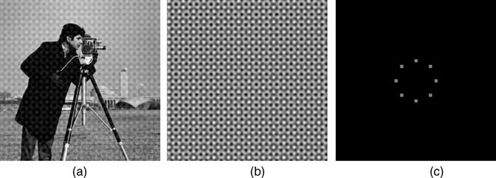
NOISE REDUCTION USING FREQUENCY DOMAIN TECHNIQUES
Periodic Noise: arises as a result of electrical or electromechanical interference during the image acquisition process.

Slide 13
Bandreject Filter
attenuates frequency components within a certain range (the stopband of the filter), while leaving all other frequency components untouched

Slide 14
Bandpass Filter
Allows certain frequencies (within its passband) to be preserved while attenuating all others

Slide 15

IMAGE DEBLURRING TECHNIQUES
G(u, v) = F(u, v)H(u, v) + 0

Slide 16

Wiener Filtering
Is an image restoration solution that can be applied to images that have been subject to a degradation function and also contain noise
K is a constant used to approximate the amount of noise

Slide 17
In MATLAB
deconvreg: deblur image using regularized filter
deconvlucy: deblur image using Lucy–Richardson method
deconvblind: deblur image using blind deconvolution

Slide 18
Hands-on
Tutorial 12.1
Problems

